Slide 1
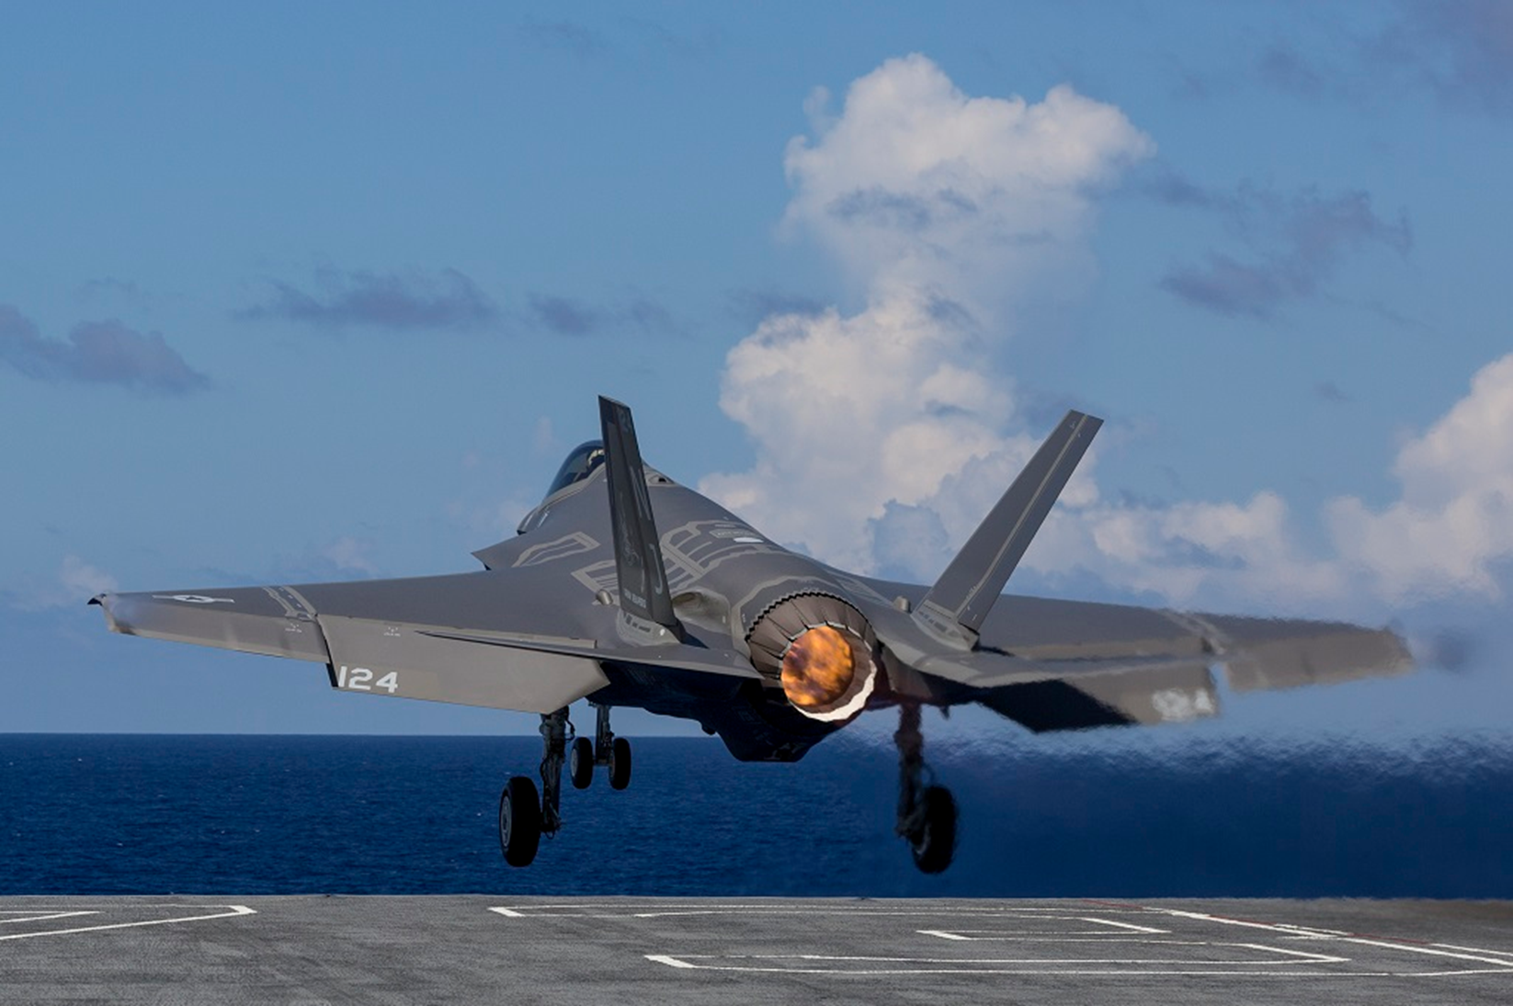
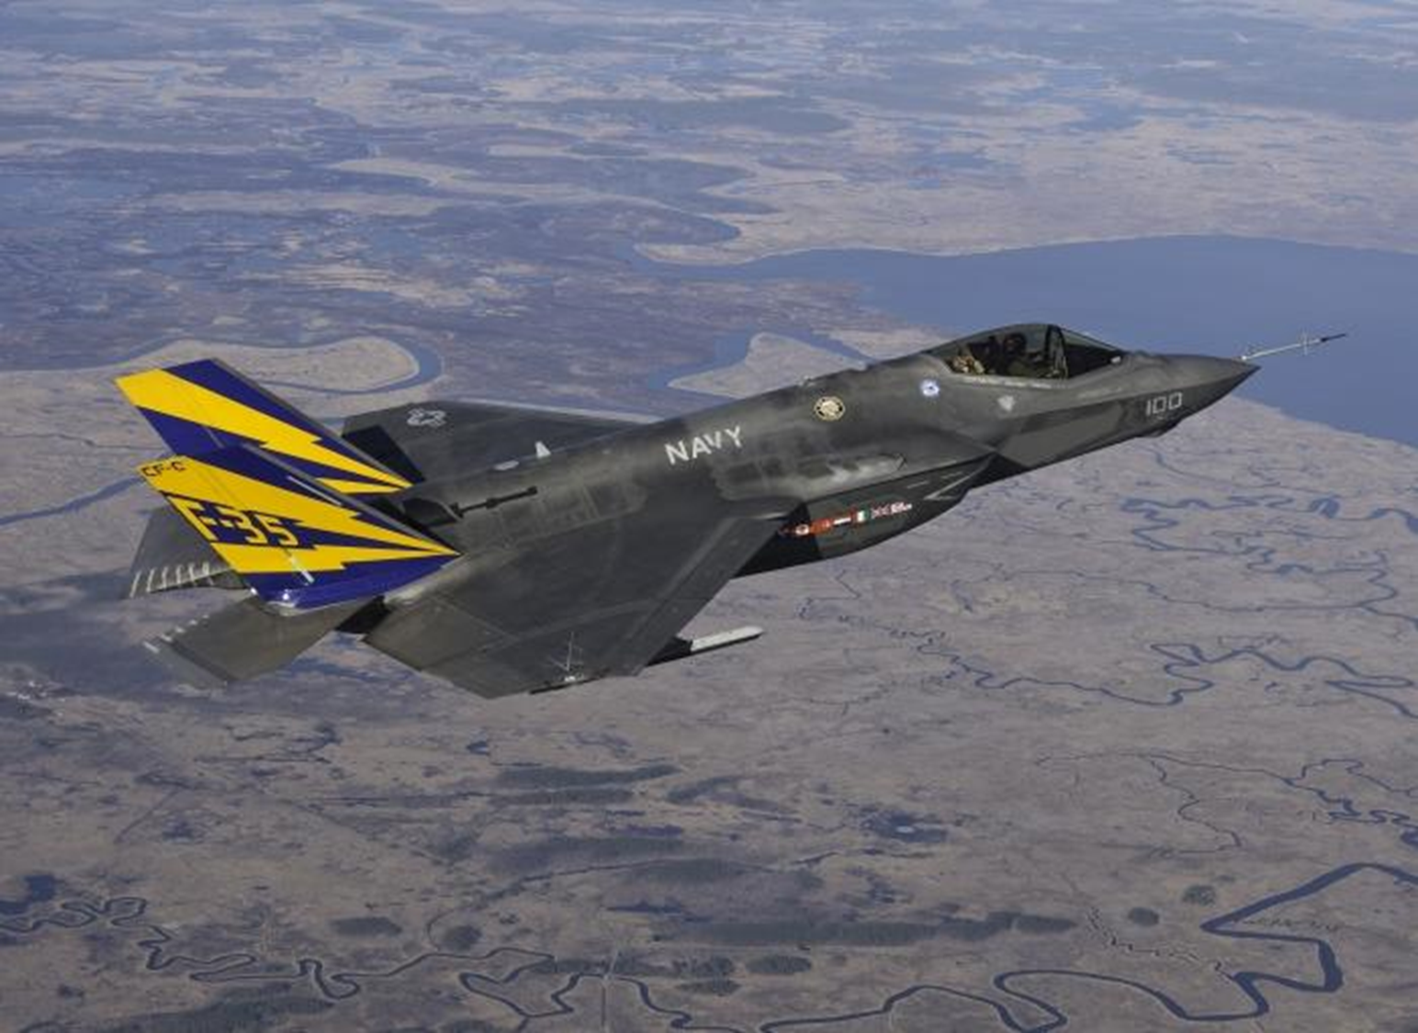
F-35 Electro-Optical Targeting System
Producibility Improvements Save More Than $224M
Six phases of Navy ManTech projects are significantly improving the affordability of F-35 infrared components
.
WHAT IS IT?
HOW DOES IT WORK?
WARFIGHTER BENEFITS
The Office of Naval Research ManTech Program’s Electro-Optics Center conducted projects, executed under six phases, that are significantly improving the affordability of the F-35 Electro-Optical Targeting System (EOTS). EOTS is a high-performance, lightweight, multi-functional system for precision air-to-air and air-to-surface targeting. The system provides high-resolution imagery, automatic tracking, infrared search-and-track, laser designation with range finding, and laser spot tracking at greatly increased standoff ranges. Funded by the Air Force, Navy, and Defense-Wide Manufacturing Science & Technology Program, the EOTS efforts have optimized manufacturing processes for F-35 infrared components, including the integrated Dewar cooler (IDC) and the focal-plane array (FPA).
Phases 1-3 implementation of improved and automated FPA and IDC manufacturing processes, tools, and equipment (significantly reduced cost and increased yield and reliability).
Phase 4 is transitioning the mid-wave infrared IDC to a high operating temperature advanced detector (will increase capacity, significantly reduce FPA cost and increase the reliability).
Phase 5 is implementing an FPA batch manufacturing process (significantly lowers manufacturing costs) and automating the lower vacuum assembly test station (significantly decreases manufacturing time and rework costs).
Phase 6 is implementing an in-situ etch and passivation tool (improves yield and reliability and reduces cost) and implementing wafer photolithography improvements (streamlines manufacturing process, reduces cost, and improves yield).
Phase 1 The project increased the Manufacturing Readiness Level from 4 to 8 while reducing the cost per IDC assembly by 19%, saving over $117M. The return on investment (ROI) is over 25X for the F-35 Program.
Phase 2 The project provided affordability savings of over $18M. The ROI is over 43X for the F-35 Program.
Phase 3 The project provided affordability savings of over $5M. The ROI is over 7X for the F-35 Program.
Phase 4 The project is expected to save over $62M for the F-35 Program when implemented in 2021.
Phase 5 The project is expected to save over $19M for the F-35 Program when implemented in 2021.
Phase 6 The project is expected to save over $3M for the F-35 Program when implemented in 2022.
Total Estimated Savings of More Than $224M
INTERESTING FACT
The F-35 EOTS Producibility Phase 1 project was awarded the 2015 Defense Manufacturing Technology Achievement Award.
Distribution Statement A: Approved for public release; distribution is unlimited.
NRE 2021

