Slide 1
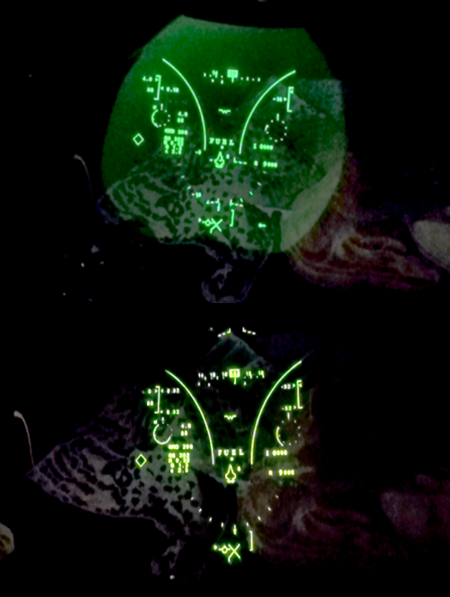
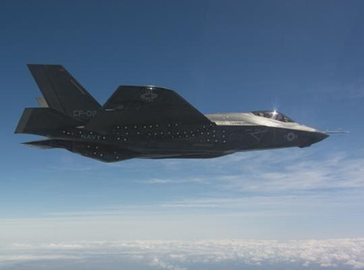
ManTech Improves Manufacturability of
F-35 OLED Helmet-Mounted Display
Makes Difference Between Day and Night for Pilots
Top: The green glow exhibited by the F-35 Lightning II helmet makes it difficult for pilots to see in low light conditions.
Bottom: ManTech developed a manufacturing process to assemble an OLED display into the existing optical train of the F-35 HMDS.
The ManTech project supported the IOC of the F-35C. Photo credit: Dane Wiedmann, Lockheed Martin
WHAT IS IT?
HOW DOES IT WORK?
WARFIGHTER BENEFITS
A Government Accountability Office (GAO) report 18-321, published in June 2018, stated that the current liquid crystal display (LCD) for F-35 helmets exhibits a characteristic “green glow” during low-light flights, which makes it difficult for pilots to see the full resolution of the night vision video feed. The GAO report concluded that, “Organic light-emitting diode displays avoid this effect by only illuminating the active pixels.” An Electro-Optics Center (EOC) project sponsored by ONR’s Manufacturing Technology (ManTech) Program developed and demonstrated a manufacturing process to assemble an organic light-emitting diode (OLED) display into the existing optical train of the F-35 Lightning II helmet-mounted display system (HMDS).
ManTech independently tested the lifetime performance of the OLED devices. Using a physics-based stochastic model and thousands of hours of test data, ManTech was able to estimate that the OLED devices, which are typically subject to premature brightness decay, would be able to withstand typical use-case profiles without excessive degradation. To make the OLED technology affordable, the project reduced part count, total parts cost, and touch labor in the manufacture of OLED HMDS. The ManTech project is integral to the F-35C’s initial operational capability (IOC), which is scheduled to be achieved in 2019, and 62 OLED flight helmets have been ordered for IOC trials. Lockheed Martin has qualification testing planned, which will take the helmet to a Release Authorization Notice 6 production helmet in 2019.
In addition to technical performance improvements, the ManTech project will demonstrate cost savings in assembly time and parts handling: part count is projected to be reduced by 27 percent, and touch time labor is estimated to be reduced by 10 percent through improved tooling concepts. The projected savings are a 21 percent reduction in cost per HMDS, for total F-35 program savings of over $40M. The acquisition savings alone are estimated to be 10 times the amount of the ManTech research investment.
INTERESTING FACT
On 28 March 2019, eMagin, a contractor to HMDS manufacturer Collins Elbit Vision Systems, announced that it delivered the initial displays that are being installed in helmets for flight tests scheduled this year. Rear Adm. Dale Horan, director of the F-35C Fleet Integration Office, called the OLED technology, “an elegant solution.”
Distribution Statement A:
Approved for public release; distribution is unlimited

