Slide 1

Office of Naval Research Global (ONRG)
International Science Program
Overview
Mr. Dillard Patton
International Science Program Manager
London, UK
dillard.c.patton2.civ@us.navy.mil

Slide 2
Agenda
Department Overview
Department Organization and Structure
Why International Science?
2024 Significant Accomplishments
2025 High-Level Plans

Slide 3



Office of Naval Research Global (ONRG)
An internationally oriented arm of ONR
Mission
Vision
To obtain, coordinate, and make available
world-wide scientific information.
To be the partner of choice for science and technology leaders worldwide.

Slide 4







ONRG Organization
International Science
International Engagement
Mission
Enable future naval capabilities through revolutionary fundamental research that challenges conventional thinking.
Vision
Foster trusted partnerships with the world’s leading scientific researchers.
Fleet Science Advisors
Experimentation & Analysis
TechSolutions
Foreign Comparative Test
London Tech Bridge

Slide 5

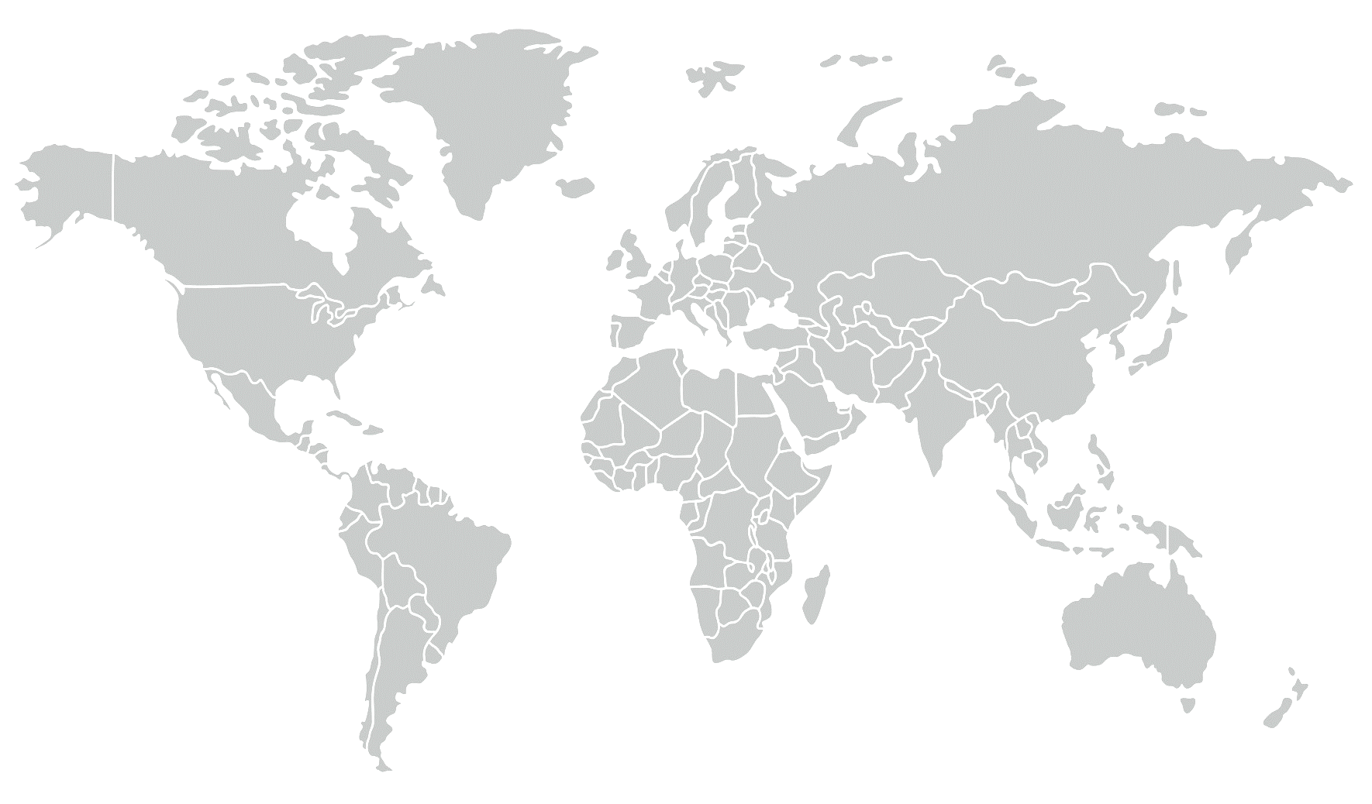

ONRG International Science
Office Locations
25 Science Directors world-wide
ONR Global HQ
London, UK
Provide a persistent global presence
Identify cutting-edge Science & Technology
Expand network of global scientists and technology innovators
Link international scientists with the Naval Research Enterprise
Award seed grants to stimulate promising international research
Prague,
Czech Republic
ONR HQ
Arlington, VA
Tokyo, Japan
New Delhi, India
Singapore
São Paulo, Brazil
Santiago,
Chile
Melbourne,
Australia

Slide 6
ISP Functional Org Chart
ISP Census Total Manpower = 25 personnel
Core Billets: 8 (1 ONR Core)
Detail/Term Appointees: 12
IPA: 1
Military: 1
ASDs (LE Staff): 3

Slide 7
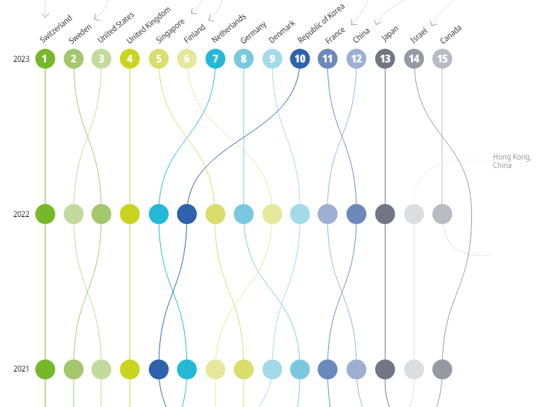
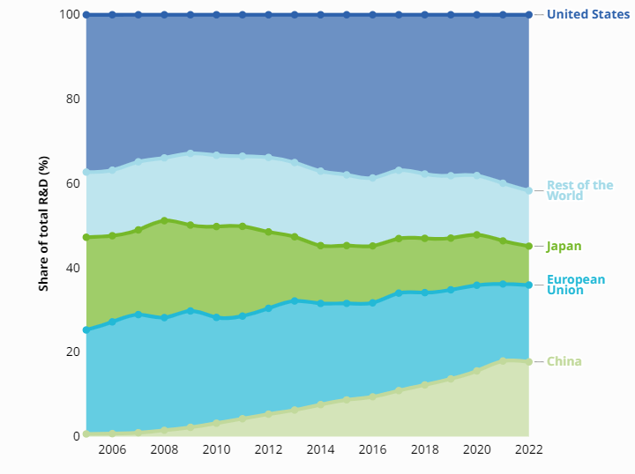
Why International Science?
U.S. is a lead global innovator…
…but the majority of R&D investment is outside our borders.
Global Innovation Index Top 15 innovators 2021-2023
Global R&D investment distribution by economy/region, 2006-2022
Investing in fundamental research to nourish bold ideas, leading to breakthroughs that will reshape future capabilities.
Bold ideas come from highly trained & highly creative scientists who are actively engaged in global research activities.
https://www.wipo.int/global_innovation_index/en/gii-insights-blog/2024/r-and-d-spenders.html
https://www.wipo.int/edocs/pubdocs/en/wipo-pub-2000-2023-en-main-report-global-innovation-index-2023-16th-edition.pdf

Slide 8
FY24 ISP Major Accomplishments
Officially opened the ONRG Office in New Delhi in August 2024!
2024 GlobalX International Research Challenge
  In-person teaming workshop in Tallinn, Estonia
  3 applied research awards to universities in Australia, Finland, and Chile
Initiated 163 new fundamental research projects in 60 countries, while continuing to manage 238 existing projects (401 total projects)
Collaborative Science Program (CSP)
  68 international conferences, symposiums, and workshops in 36 countries
  ● 6 in Africa ● 23 in the Americas (excluding the US) ● 17 in Europe ● 21 in Indo-Pacific
Visiting Scientists Program (VSP)
  21 scientists from 11 countries in topics ranging from maritime weather prediction to advanced superconducting quantum devices
Global Technology Awareness (Academic Liaison Visits)
  289 Liaison Visits to international universities and research institutions across 60 countries

Slide 9
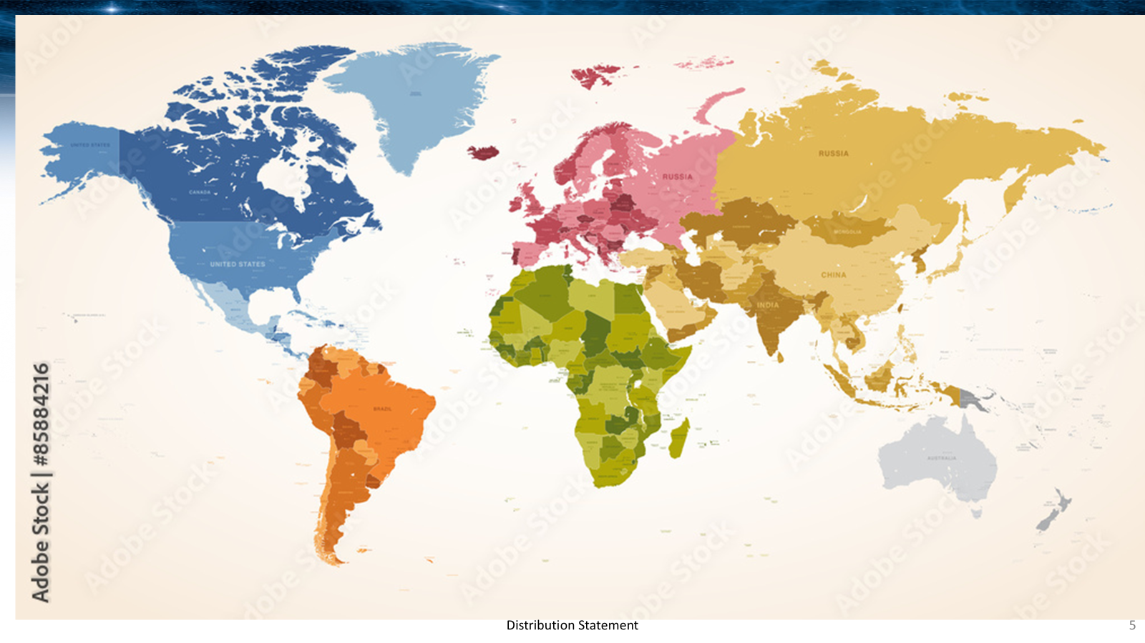
FY25 ISP High-Level Plans
S&T Global Engagement Plan (GEP) 3.0 Alignment
Out of 428 total SMART tasks, ISP has lead on a staggering 322 (75%)!!!
Region West
Engage with top universities and research institutions
Increase awareness of China S&T
Enhance ONR Global communications across NRDE and international partners (eg GTARs, Outback Outlook)
Strategic engagement in Africa
  Gulf of Guinea, Saharan & Subsahara Africa, etc
Strategic engagement in Latin America
Region East
Engage with top universities and research institutions
Increase awareness of China S&T
Enhance ONR Global communications across NRDE and international partners (eg GTARs, Outback Outlook)
Taiwan workshop on Ocean Science
GlobalX: Singapore Martime AI Grand Challenge

Slide 10
Questions?

